Slide 1
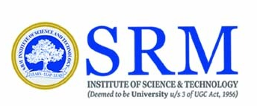
VISIONTEXT-LLM
SRM Institute of Science and Technology
College of Engineering & Technology | School of Computing
Department of Computing Technologies
21CSC306T Artificial Intelligence – Mini Project
Team Members
RA2311026010006 Anjany Kumar Jaiswal

Slide 2
Abstract
The VisionText-LLM project introduces a multimodal Retrieval-Augmented Generation (RAG) system that seamlessly integrates textual and visual data to provide enriched, contextually relevant answers to user queries. By embedding both text and images into a shared vector space, the system enables semantic retrieval and leverages a multimodal Large Language Model (LLM) to generate comprehensive responses without relying on Optical Character Recognition (OCR). This approach enhances information retrieval from documents containing diverse data types, offering a more holistic understanding and interaction with content.​

Slide 3
Introduction
In today's information-rich environment, documents often encompass a blend of textual and visual elements. Traditional retrieval systems primarily focus on text, overlooking the valuable insights embedded in images. The VisionText-LLM project addresses this gap by developing a system that processes and understands both modalities. By embedding text and images into a unified vector space, the system facilitates semantic retrieval and employs a multimodal LLM to generate responses that consider the full spectrum of document content. This integration aims to improve the accuracy and relevance of information retrieval in complex, multimodal documents.​

Slide 4
Challenges / Motivation
Limitations of OCR: OCR technologies can struggle with accurately extracting text from images, especially when dealing with complex layouts or low-quality visuals.​
Isolated Modal Processing: Conventional systems often process text and images separately, missing out on the synergistic insights that a combined analysis can offer.​
Semantic Retrieval Difficulties: Retrieving relevant information based on the semantic content of both text and images poses significant challenges.​
Advancements in Multimodal Models: The emergence of multimodal large language models presents new opportunities to overcome these challenges by enabling integrated processing of diverse data types.​

Slide 5
Problem Statement
Existing information retrieval systems often fail to effectively process and integrate visual data, leading to incomplete or inaccurate responses when dealing with multimodal documents. There is a need for a system that can semantically understand and retrieve information from both text and images, providing comprehensive answers without relying on OCR for image content extraction.

Slide 6
Existing System / Work
Traditional retrieval systems primarily focus on textual data, utilizing keyword matching or basic semantic search techniques. Some advanced systems incorporate OCR to extract text from images; however, OCR can be unreliable, especially with complex or low-quality images. These systems often lack the capability to understand and integrate visual context effectively, leading to suboptimal information retrieval from multimodal documents.

Slide 7
Proposed System / Work
VisionText-LLM introduces a multimodal RAG framework that integrates both
text and image data into a shared embedding space. The system operates as
follows:​
Data Extraction: Extracts textual and visual content from documents.​
Embedding Generation: Utilizes multimodal encoders to generate embeddings for both text and images, mapping them into a unified vector space.​
Semantic Retrieval: Performs semantic search within the embedding space to retrieve relevant content based on user queries.​
Response Generation: Employs a multimodal large language model to generate contextually enriched responses that incorporate information from both text and images.​
This approach enhances the system's ability to comprehend and respond to complex queries involving diverse data types, providing more accurate and informative results.​

Slide 8
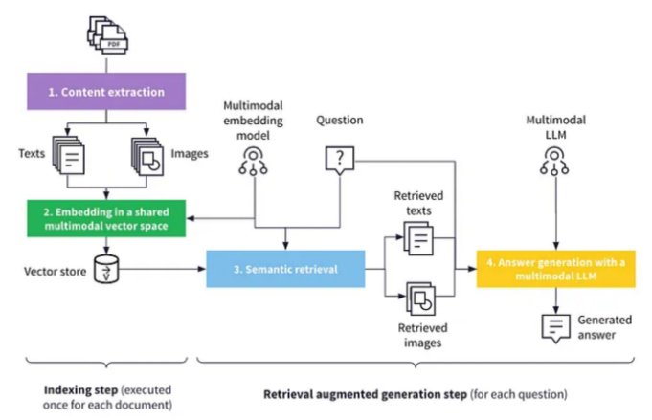
Architecture / Data Flow Diagram

Slide 9
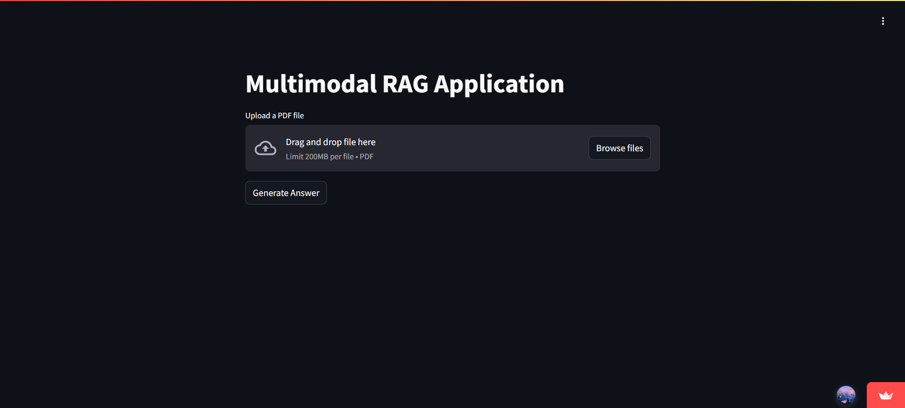
Prototype / Application Developed
Screen-Shot of the Application that has been developed
Github Repo of the application : (https://github.com/AnjanyKumarJaiswal/VisionText-LLM)

